Slide 1

Minor project presentation on Loan Approval Prediction
Trainer: Team Members:
Mrs .Amrutha Kedar Chimote Ms. Sridurgadevi Ravikumar
(Edubridge Learning pvt.ltd) Ms. Pooja BC
Batch:2021-2022

Slide 2
Presentation Outline:
Introduction
Objectives
Process and software specification
Result and discussion
Conclusion.

Slide 3
Introduction:
Loan analysis is an evaluation method that determines if loans are made on feasible terms and if potential borrowers can and willing to pay back the loan.
It checks the eligibility of the potential borrower against the criteria set forth for lending.
Loan analysis helps in assessing the skills and financial knowledge of the borrower to determine the level of risk involved.

Slide 4
Objectives:
The prime objective of our project is very clear from the project title itself. We want to predict whether an applicant can be approved of loan or not by applying machine learning techniques.
Learn to deal with missing data .
Learn to analyze given data by performing exploratory data analysis.
Go through different machine learning algorithms and understand how they work.
To build a machine learning model to predict loan approval.

Slide 5
Process and Software Requirement
Hypothesis Generation
Missing Value Treatment
Exploratory Data Analysis
Univariate Analysis Bivariate Analysis
Model Building SVM Logistic Regression
Prediction.

Slide 6
Process Model
.
Gather known Data
and known response
Understand the dataset
Clean the dataset
Visualization
Train the Model
Fine tune the model
Use model with new data
For prediction

Slide 7


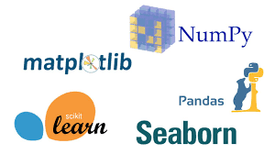
Software Requirement: Python Libraries Used: Jupyter Notebook NumPy Pandas Seaborn Matplotlib Scikit Learn

Slide 8
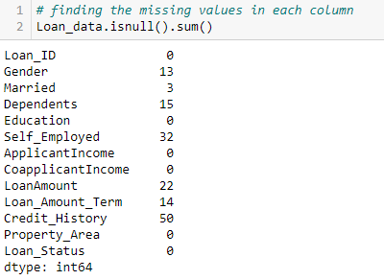
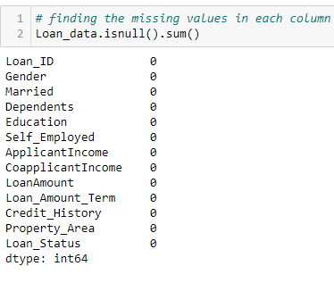
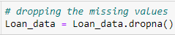
Missing Values Treatment:

Slide 9
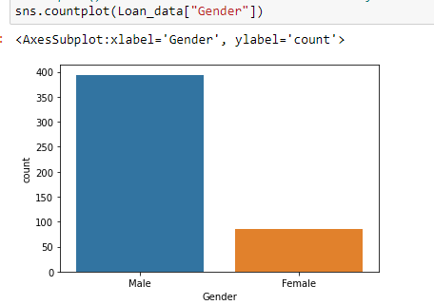
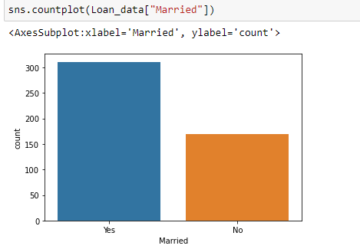
Exploratory Data Analysis Univariate analysis: *Around 80% of the applicants are male *Around 65% of the applicants are Married.

Slide 10
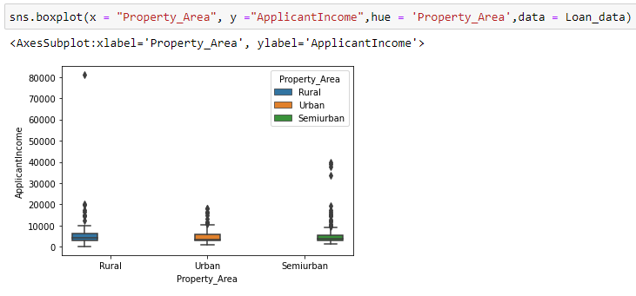
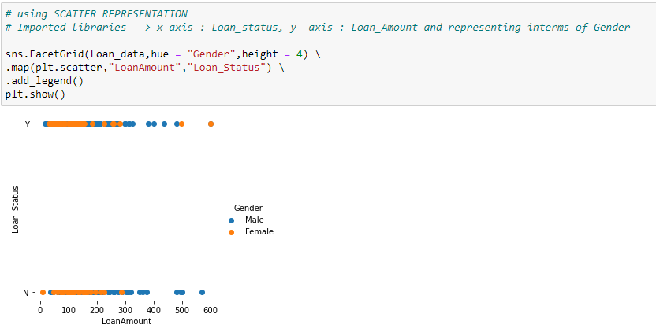
Bivariate Analysis: *The Graph Represents the minimum, first quartile, * Applicants who applied for minimum loan amount median,3rd quartile, maximum values. have more chances of getting loan.

Slide 11
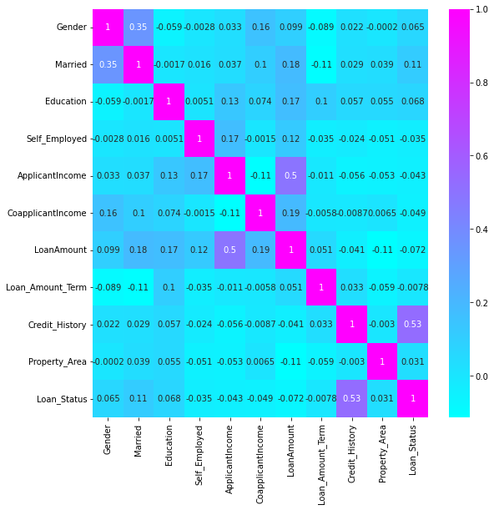
Correlation Matrix:
corr=Loan_data.corr() plt.figure(figsize=(9,9)) sns.heatmap(corr,annot=True,cmap='cool’)
* From the above graph it is clear that applicant income and loan amount ,credit history and Loan status have significant relationship.

Slide 12
Result and Discussion: Machine Learning: machine learning is the branch of study that makes the uses of algorithms for computer to learn from the data and improve its accuracy by itself through experience. Classification: Classification algorithms are mainly used to identify the category of any given data set and predict the output for the absolute data. Classification algorithms: 1.Support Vector Machine(SVM). 2.Logistic Regression.

Slide 13
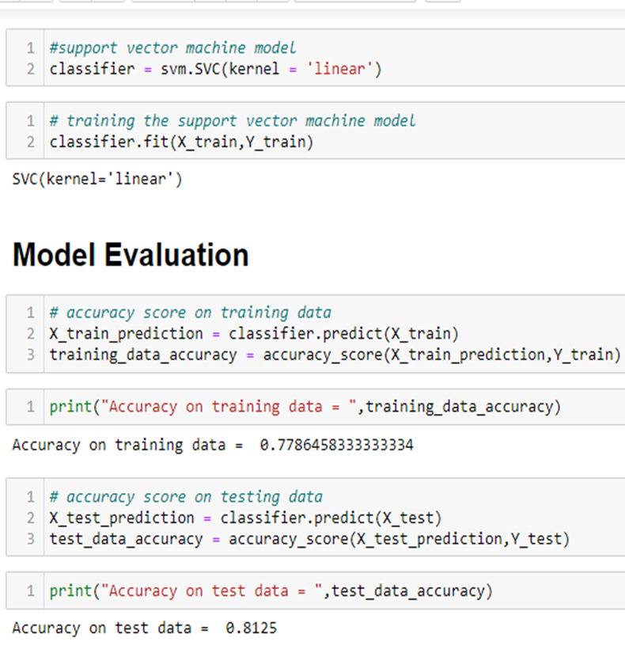
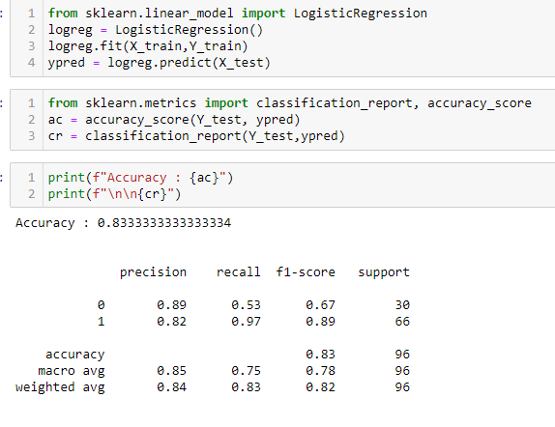
MODEL BUILDING
SVM
LOGISTIC REGRESSION

Slide 14
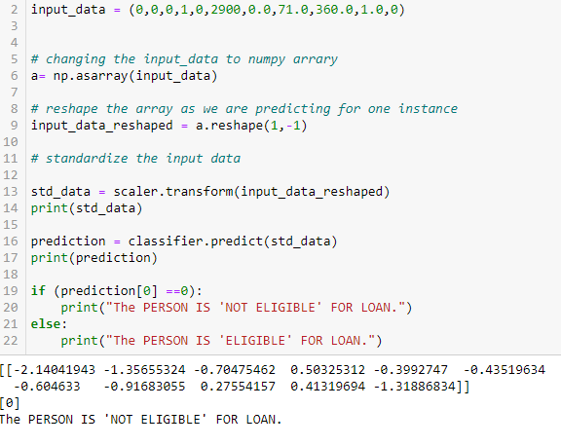
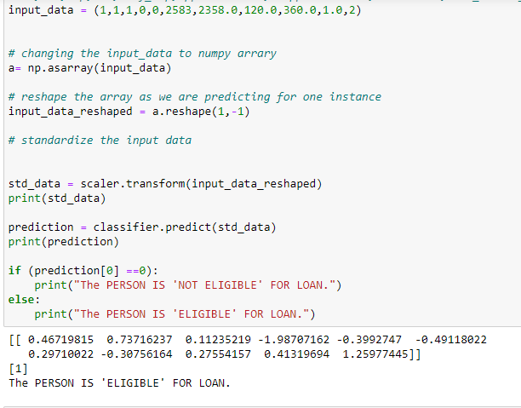
Prediction: #Gen,Mar,Dep,Edu,Self_Emp,ApplicantInco,CoapplicantInco,LoanAmount,Loan_Amount_Term,Credit_History,Property_Area
.

Slide 15
Conclusion:
We understood the data.
We Explore the data on the features of this dataset and get the insights of the data.
Credit History plays a huge role in loan status compared to other variables.
We go through the machine learning algorithms like SVM and Logistic Regression and understood how they work.
Finally we build a model ,check for the unknown data and predicted whether the person will get loan or not.

Slide 16
Thank you

